Slide 1




Future of Genetically Modified Food and Preservatives
REPRESENTED BY: sejal, sneha, neha, gayatri, sonali, snehac., bhoomika, harsha, janvi, priyanka, babli.

Slide 2



Table Of Contents
1st
3rd
Part
Part
Part
Part
DEFINITION
PROCESS ENVOLVED
NEED
WORLD STATISTICS
INDIAN STATISTICS
ENVIRONMENT
EXAMPLES
ADVANTAGES
DISADVANTAGES
CONCLUSION
FUTURE SCOPE
END
2nd
4th

Slide 3

Part 01
AIM: To understand all the scientific

Slide 4
SCIENTIFIC DEFINITION
Genetically Modified food
Genetically modified food (or GM food) is food produced from plants or animals whose DNA has been altered through genetic engineering.

Slide 5
PROCESS
Step 1
INSERTING
Step 2
SELECTION
GROWING
Step 3
COPYING
Step 4

Slide 6
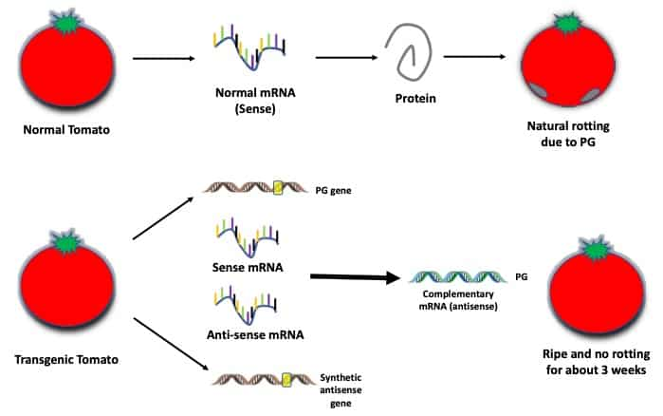
Understand with an example

Slide 7
WHY WE NEED THIS?
HUNGER DEATH
TO LOWER TIME, LABOUR & LAND REQUIRED
CLIMATE CHANGE EFFECTS
LAND FERTILITY PROBLEMS
TO OVERCOME

Slide 8
Part 02
AIM: To see examples, advantages and disadvantages

Slide 9
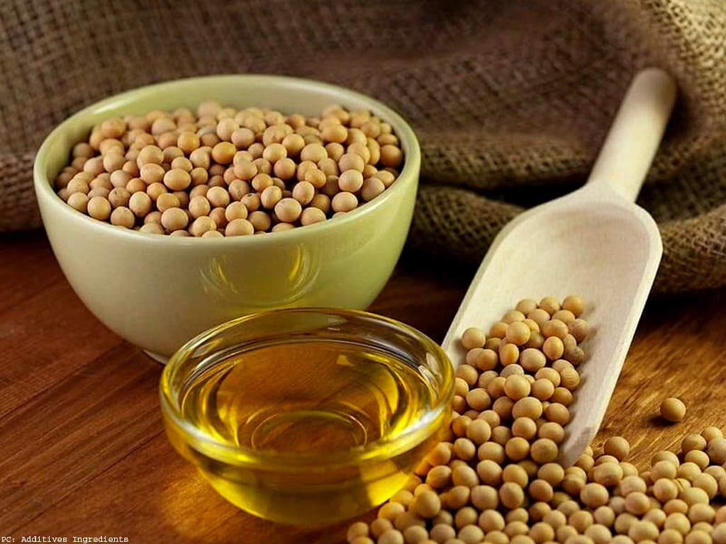
Soybean
Examples

Slide 10
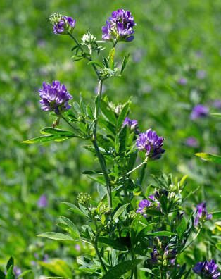
Alfalfa
Examples

Slide 11
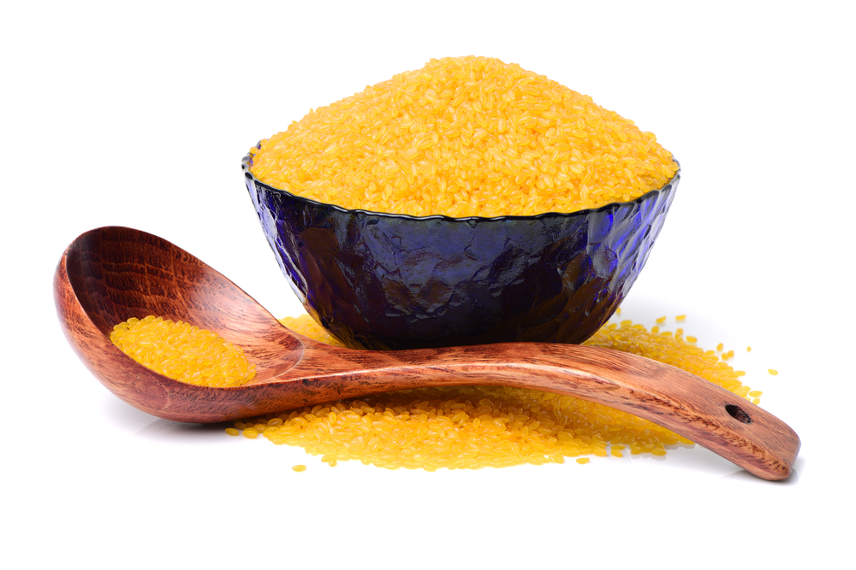
Golden rice
Examples
AND MANY MORE...

Slide 12



ADVANTAGES
ENHANCED NUTRITIONAL VALUE
SUSTAINABLE FOOD PRODUCTION
IMPROVED SHELF-LIFE
LESS USE OF LABOUR & LAND
LESS USE OF PESTICIDES
REDUCED MATURATION TIME

Slide 13
DISADVANTAGES
RESISTANT TO ANTIBIOTICS
ALLERGIC REACTIONS
UNINTENDED HARM TO ORGANISMS
LONG TERM EFFECTS

Slide 14
Part 03
AIM: To understand the statics and relation with environment

Slide 15
WORLD STATISTICS

Slide 16
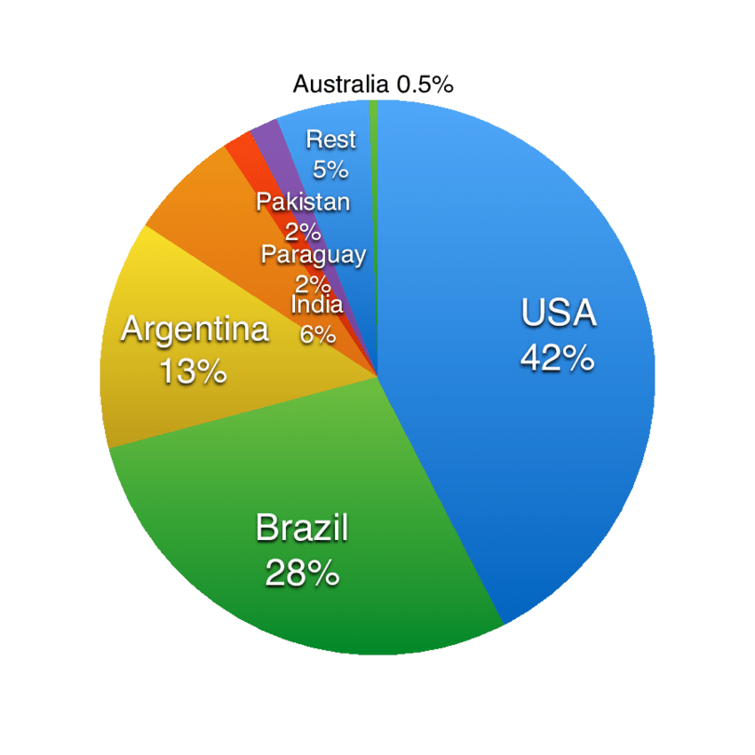
COUNTRY-VICE :

Slide 17
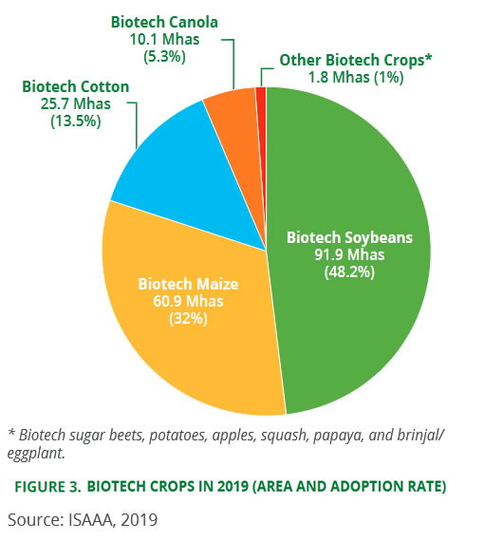
CROP-VISE:

Slide 18
INDIAN STATISTICS

Slide 19
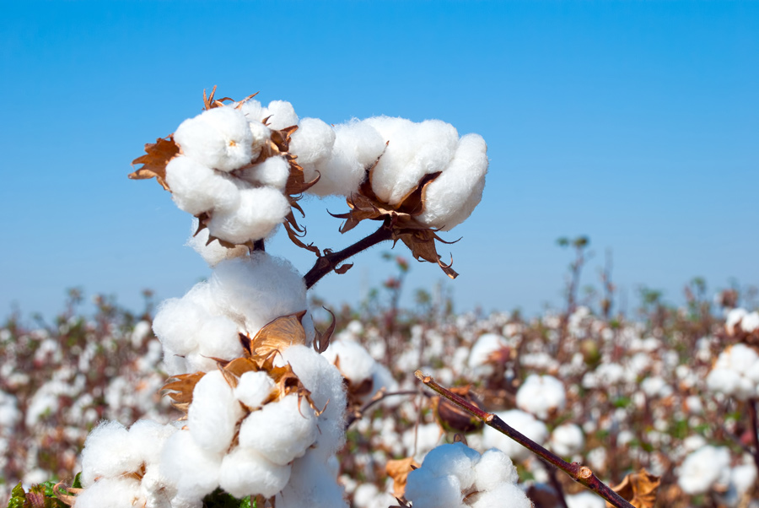
LARGEST PRODUCER OF BT. COTTON
7.5 MILLION FARMERS AND THEIR FAMILIES ENJOYED THE BENEFITS OF PLANTING BT. COTTON
OTHER PRODUCTS ARE IN PROCESS...

Slide 20
GM FOOD AND THE ENVIRONMENT
GENETICALLY MODIFIED FOODS ARE SAFE?
YES

Slide 21
HOW?
SOME REGULATORY AGENCIES ARE:
USA :FDA(Food and Drug Administration)
EPA(Environmental Protection Agency)
USDA( United States Department of Agriculture)
EXTENSIVE TESTS
REGULATIONS
EUROPEAN UNION: EFSA(European Food Safety Authority)
INDIA: GEAC(Genetic Engineering Appraisal Committee)

Slide 22
Part 04
AIM: To see the future and conclusion

Slide 23

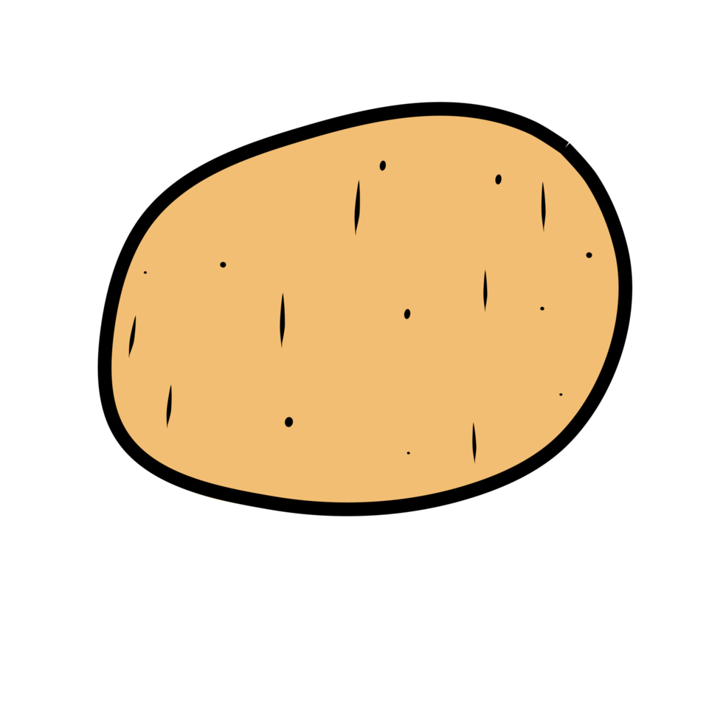
FUTURE SCOPE of genetically modified food
FUTURE IS BRIGHT AND BROAD

Slide 24
CONCLUSION

Slide 25
WE ARE GOING TO FINISH WITH THE SLIDES...
ANY QUESTIONS?

Slide 26
THANK YOU!

